Slide 1
Figure S2: Compound induced biomarker expression in HepG2 cells. The presented values (relative expression fold changes) represent mean values that were calculated from 3-5 independent experiments. The error bars illustrate the standard deviation of the independent experiments. A gene was considered to be up regulated when crossing the threshold line, which illustrates a significant increase of at least 2.5 fold change induction.

Slide 6
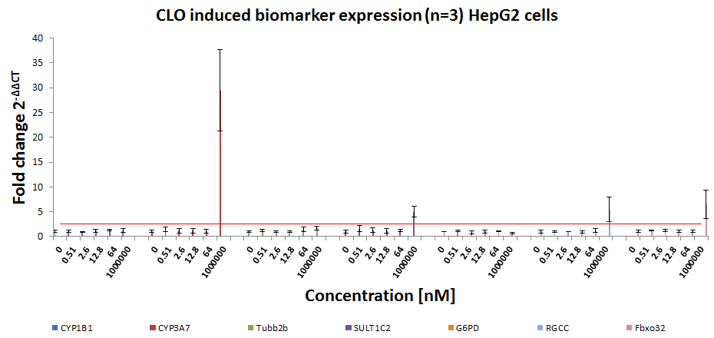

Slide 11
